Slide 1

Efforts by
Project Under Supervision of
Prof. Vishwambhar Nath Mishra
Raghav Agrawal – 20095140
Vikrant - 20095123
Nelson Rahul Tigga – 20095072
Abhinav Raj – 20095001

Slide 2

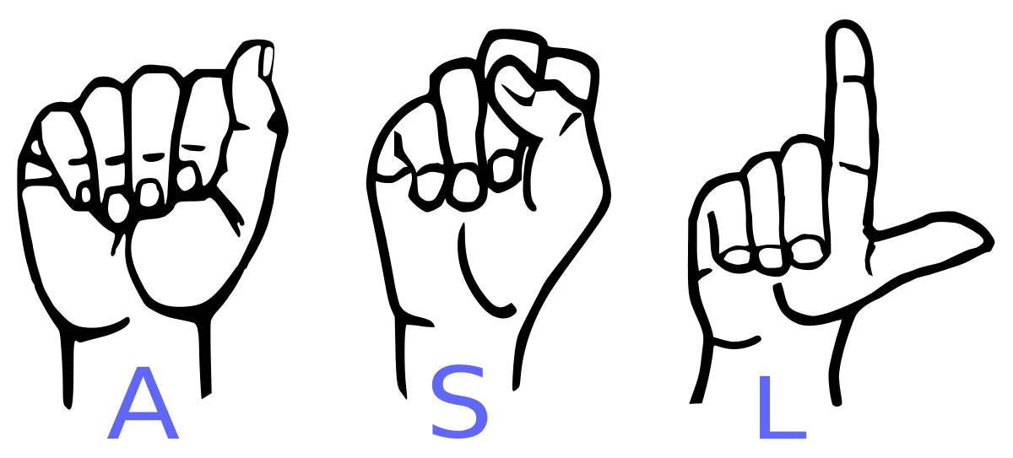
Conversion of Sign Language to Text
For Dumb and Deaf

Slide 3
Abstract
Our project aims to create a computer application and train a model that uses a deep learning model trained on the ASL Dataset to predict the sign from the sign language given an input image or frame from a video feed.

Slide 4
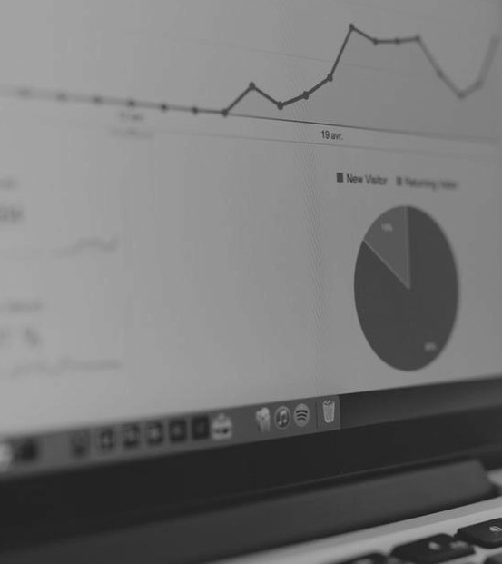
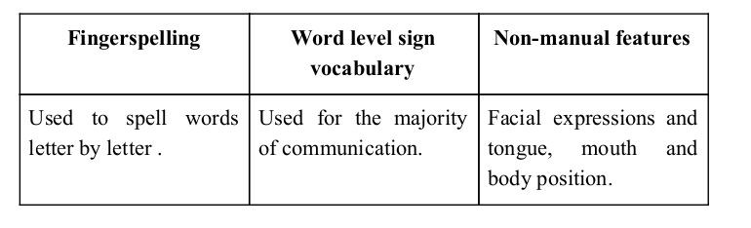
Sign language is a visual language and consists of 3 major components:

Slide 5
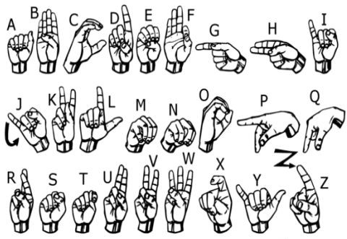
We implemented 29 symbols (26 English Alphabets and 3 additional signs of SPACE, DELETE and NOTHING) of ASL in our project.

Slide 6
Approach We will utilize a method called Data Augmentation along with Transfer Learning to create a deep learning model for the ASL dataset

Slide 7
How we created the model?

Slide 8
Data Augmentation Data Augmentation is simple technique that is widely used to increase the diversity of the training data set

Slide 9
How data set was generated? This model was trained on the dataset of American Sign Language (ASL) that is available on the Kaggle. To train the model with better real-world scenarios, we’ve augmented the images using the brightness shift ( ranging in 20% darker lighting conditions) and zooming shift (zooming out up to 120%)

Slide 10
Transfer Learning Transfer learning is a machine learning technique that uses a pre-trained model on some other same type of task. Some transfer learning models that are used with image data are: i) Oxford VGG Model ii) Google Inception Model iii) Microsoft ResNet Model

Slide 11
CNN Classifier Model

Slide 12
Inception V3 as Base Model Our model’s architecture uses Google Inception v3 as the base model. The first 248 out of 311 layers of the model (i.e. up to the third last inception block) are locked, leaving only the last 2 inception blocks for training. We’ve also removed the fully connected layers at the top of Inception network and added our own set of fully connected layers after the inception network so as to conform the neural network for our application. We’ve added 2 fully connected layers, one consisting of 1024 ReLU units and the other of 29 Softmax units for the prediction of 29 classes. The model is then trained on the set of new images for the ASL Application.

Slide 13
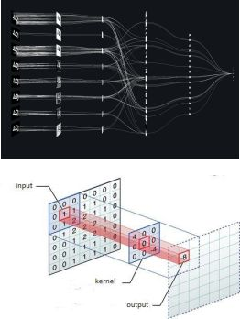
Convolutional Neural Networks
CNNs consist of multiple convolutional layers each layer containing numerous “filters” which perform feature extraction.
Initially these “filters” are random and by training, the feature extraction gets better by better.
It’s primarily used for image classification.

Slide 14
Model Training

Slide 15
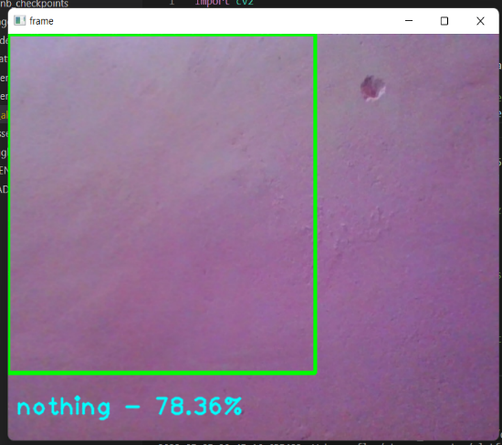
For training, Categorical Crossentropy was used to measure the loss along with Stochastic Gradient Descent optimizer (with learning rate of 0.0001 and momentum of 0.9) to optimize our model. The model is trained for 24 epochs.
After the model is trained, it is then loaded in the
application. OpenCV is used to capture frames
from a video feed. The application provides
an area (inside the green rectangle) where the
signs are to be presented to be detected or
recognized.

Slide 16
Model Testing

Slide 17
The signs are captured in frames using OpenCV, the frame is processed for the model and then fed to the model. Based on the sign made, the model predicts the sign captured.
If the model predicts a sign with a confidence greater than `20%`, the prediction is presented to the user (`LOW` confidence sign predictions are predictions above `20%` to `50%` confidence which are presented with a `Maybe [sign] - [confidence]` output and `HIGH` confidence sign predictions are above `50%` confidence and presented with a `[sign] - [confidence]` output where `[sign]` is the model predicted sign and `[confidence]` is the model's confidence for that prediction). Else, the model displays `nothing` as output.

Slide 18
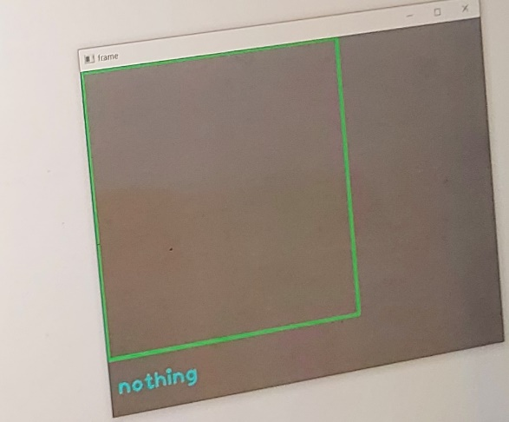
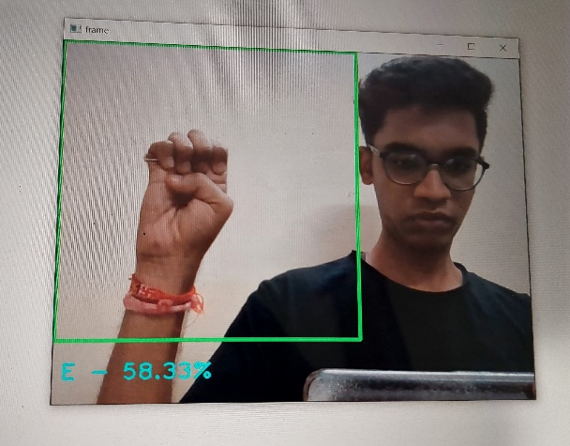
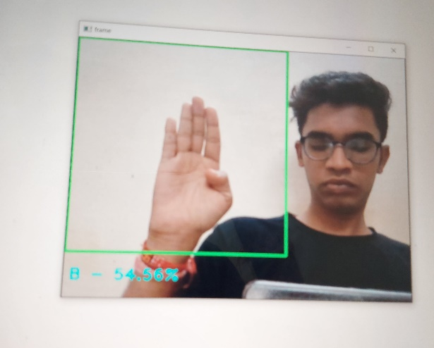
Outputs :

Slide 19
Results

Slide 20
Training Accuracy : 0.9887 or 98.87%
Training Loss : 0.1100
Validation Accuracy : 0.9575 or 95.75%
Validation Loss : 0.1926
Test Accuracy : 96.43%

Slide 21
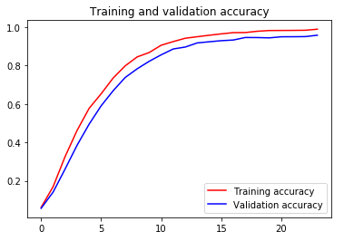
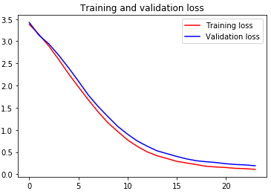
Graphical Results :

Slide 22
Limitations of our model
The model works well only in good lighting conditions.
Plain background is needed for the model to detect with accuracy.

Slide 23
Conclusion
In this report, a functional real time vision based american sign language recognition for D&M people have been developed for asl alphabets.
We achieved an accuracy of 96.43% on our dataset..

Slide 24
Future Scope
We are planning to achieve higher accuracy even in case of complex background by trying out various background subtraction algorithms
We will also be focused on how to get better results in low lightening conditions.

Slide 25
Thank You !

